Slide 1
Chapter 4
Entity Relationship (ER) Modeling

Slide 2
Learning Objectives
In this chapter, students will learn:
  The main characteristics of entity relationship components
  How relationships between entities are defined, refined, and incorporated into the database design process
  How ERD components affect database design and implementation
  That real-world database design often requires the reconciliation of conflicting goals

Slide 3
Entity Relationship Model (ERM)
Basis of an entity relationship diagram (ERD)
ERD depicts the:
  Conceptual database as viewed by end user
  Database’s main components
    Entities
    Attributes
    Relationships
Entity - Refers to the entity set and not to a single entity occurrence

Slide 4
Attributes
Characteristics of entities
Required attribute: Must have a value, cannot be left empty
Optional attribute: Does not require a value, can be left empty
Domain - Set of possible values for a given attribute
Identifiers: One or more attributes that uniquely identify each entity instance

Slide 5
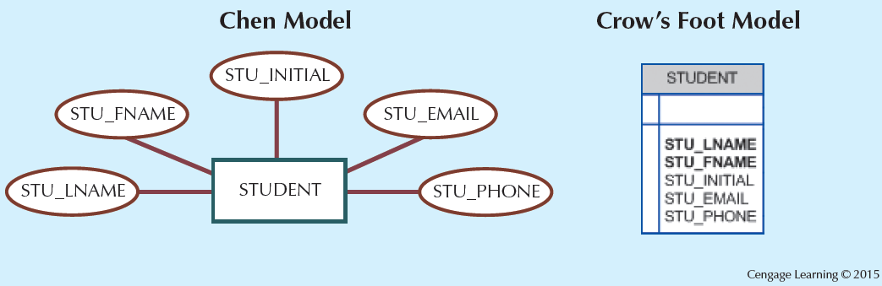
Figure 4.1 - The Attributes of the Student Entity: Chen and Crow’s Foot

Slide 6
Attributes
Composite identifier: Primary key composed of more than one attribute
Composite attribute: Attribute that can be subdivided to yield additional attributes
Simple attribute: Attribute that cannot be subdivided
Single-valued attribute: Attribute that has only a single value
Multivalued attributes: Attributes that have many values

Slide 7
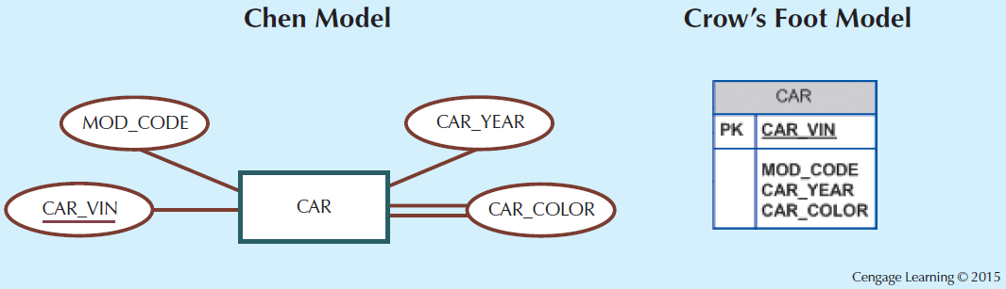
Figure 4.3 - A Multivalued Attribute in an Entity

Slide 8
Attributes
Multivalued attributes: Attributes that have many values and require creating:
  Several new attributes, one for each component of the original multivalued attribute
  A new entity composed of the original multivalued attribute’s components
Derived attribute: Attribute whose value is calculated from other attributes
  Derived using an algorithm

Slide 9
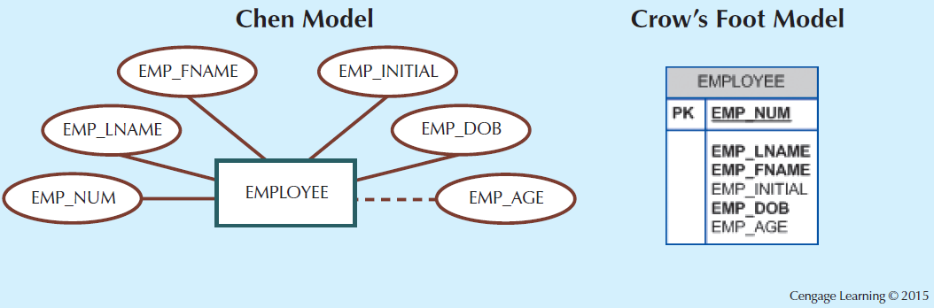
Figure 4.6 - Depiction of a Derived Attribute

Slide 10
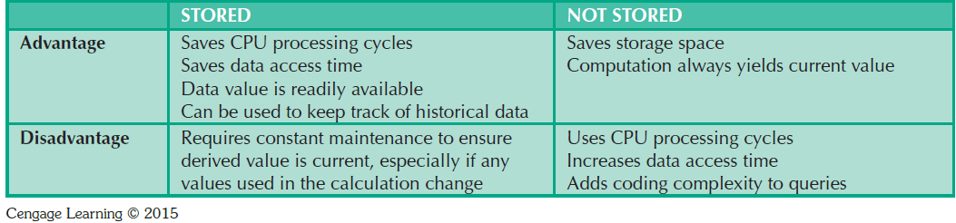
Table 4.2 - Advantages and Disadvantages of Storing Derived Attributes

Slide 11
Relationships
Association between entities that always operate in both directions
Participants: Entities that participate in a relationship
Connectivity: Describes the relationship classification
Cardinality: Expresses the minimum and maximum number of entity occurrences associated with one occurrence of related entity

Slide 12
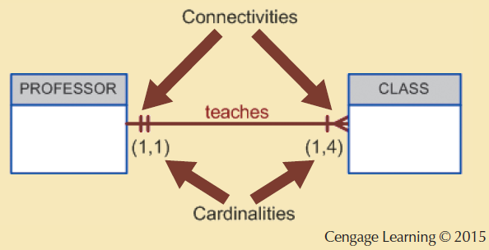
Figure 4.7 - Connectivity and Cardinality in an ERD

Slide 13
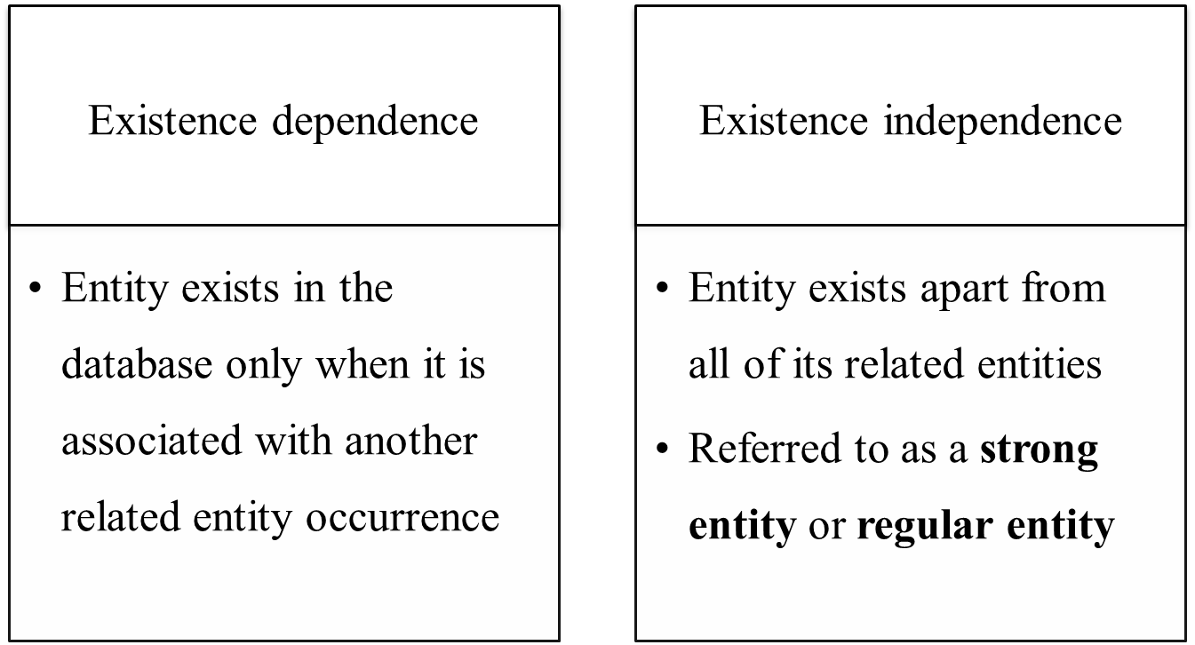
Existence Dependence

Slide 14
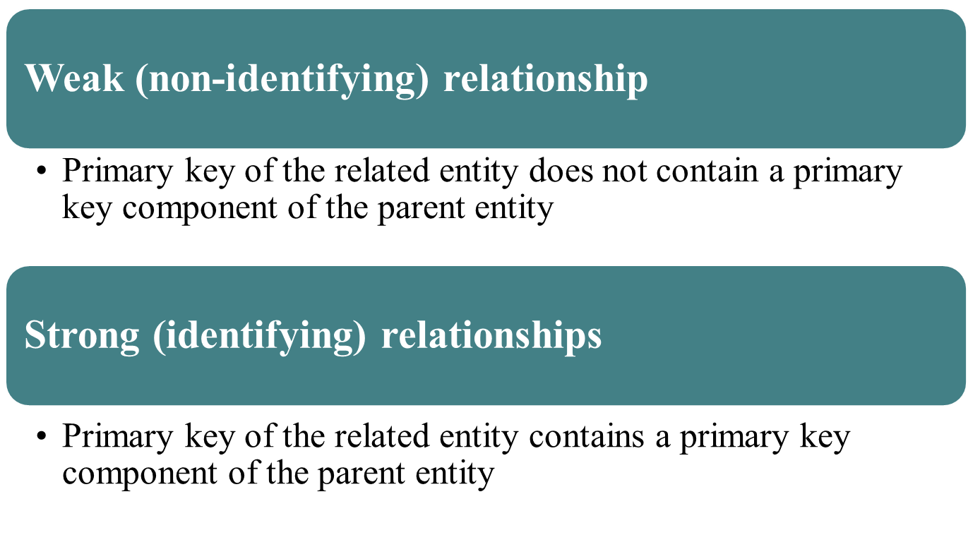
Relationship Strength

Slide 15
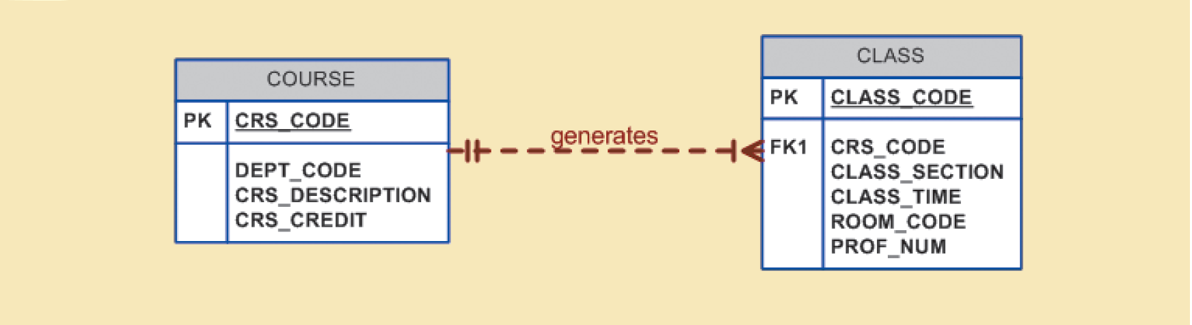
Figure 4.8 - A Weak (Non-Identifying) Relationship between COURSE and CLASS
Cengage Learning © 2015

Slide 16
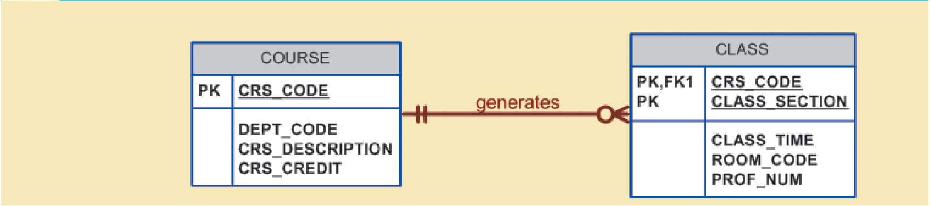
Figure 4.9 - A Strong (Identifying) Relationship between COURSE and CLASS
Cengage Learning © 2015

Slide 17
Weak Entity
Conditions
  Existence-dependent
  Has a primary key that is partially or totally derived from parent entity in the relationship
Database designer determines whether an entity is weak based on business rules

Slide 18
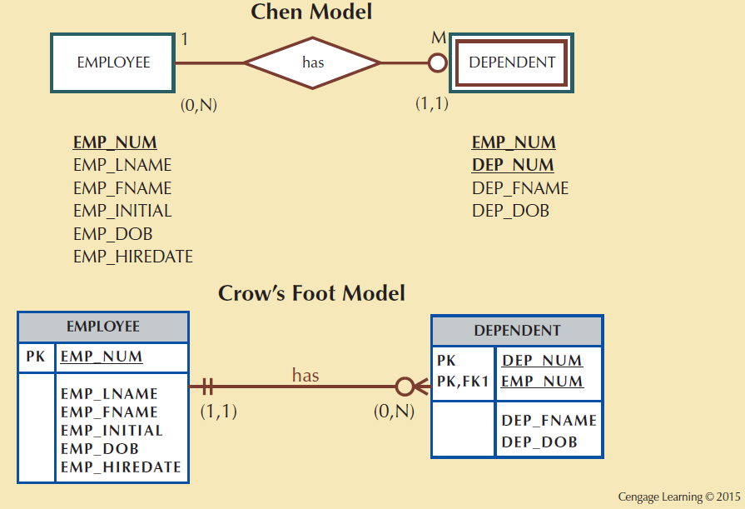
Figure 4.10 - A Weak Entity in an ERD

Slide 19
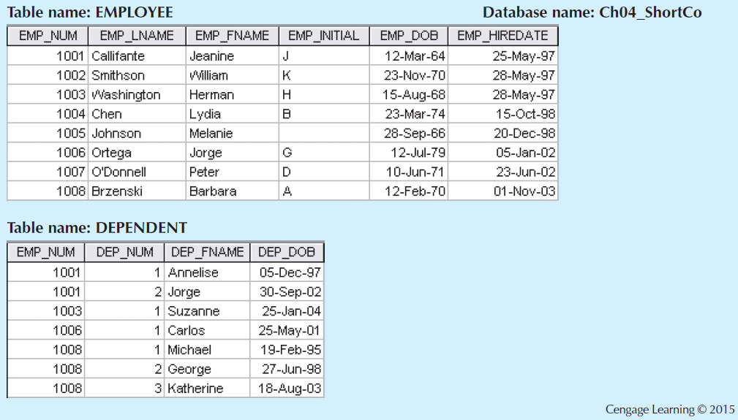
Figure 4.11 - A Weak Entity in a Strong Relationship

Slide 20
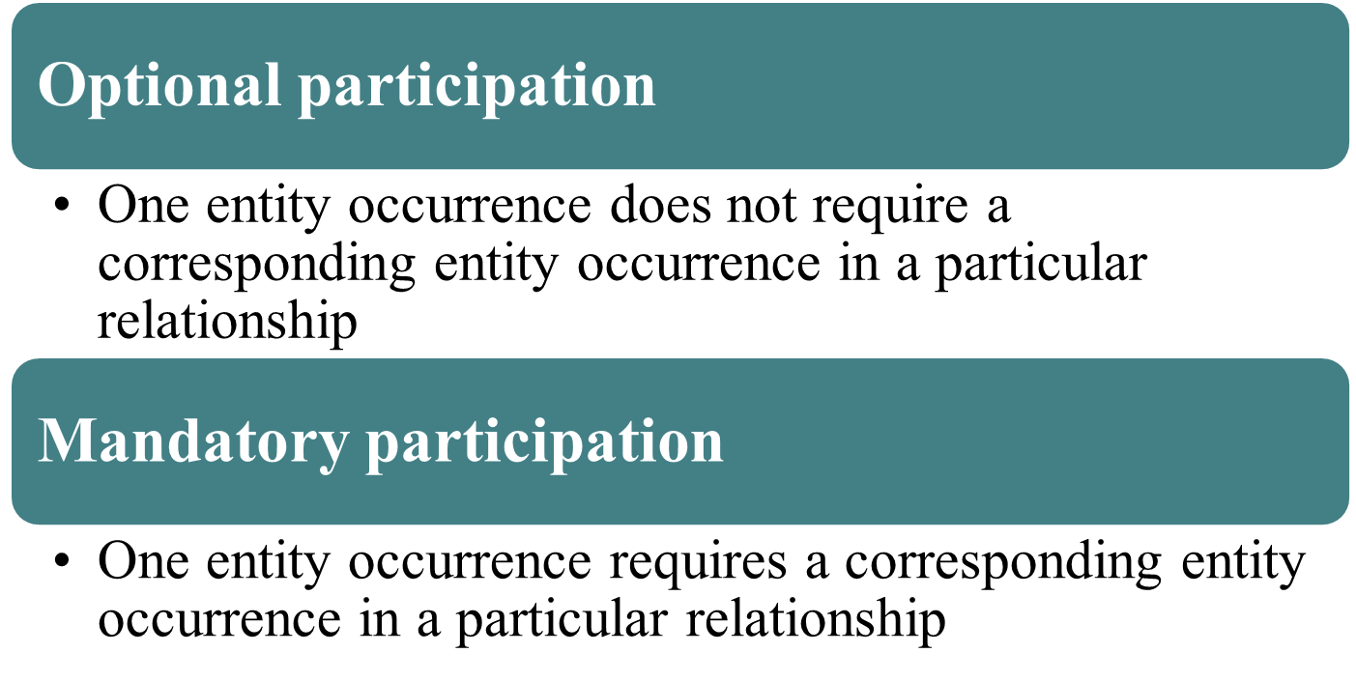
Relationship Participation

Slide 21
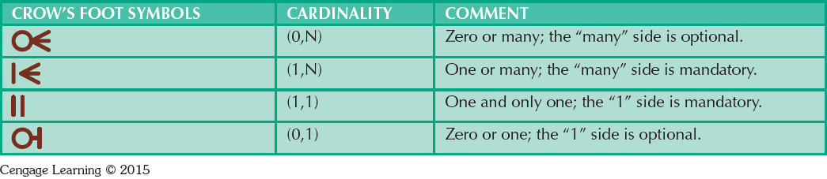
Table 4.3 - Crow’s Foot Symbols

Slide 22
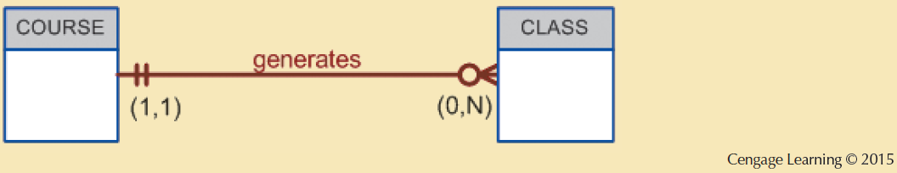
Figure 4.13 - CLASS is Optional to COURSE

Slide 23
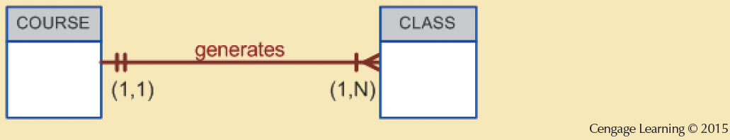
Figure 4.14 - COURSE and CLASS in a Mandatory Relationship

Slide 24
Relationship Degree
Indicates the number of entities or participants associated with a relationship
Unary relationship: Association is maintained within a single entity
  Recursive relationship: Relationship exists between occurrences of the same entity set
Binary relationship: Two entities are associated
Ternary relationship: Three entities are associated

Slide 25
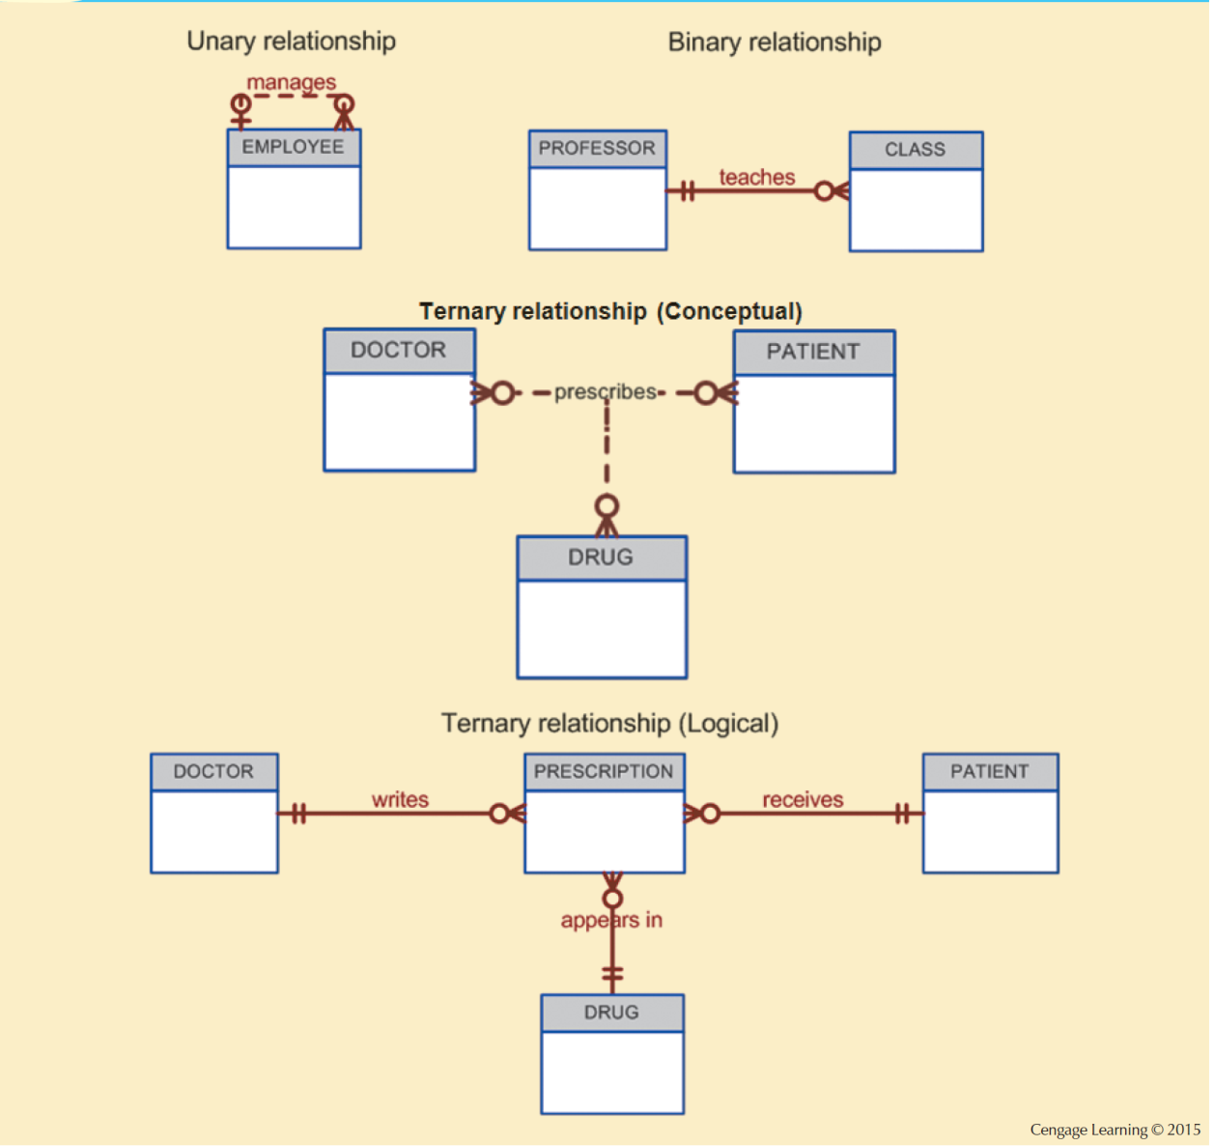
Figure 4.15 - Three Types of Relationship Degree

Slide 26
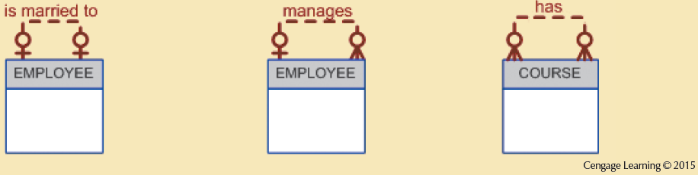
Figure 4.17 - An ER Representation of Recursive Relationships

Slide 27
Associative Entities
Also known as composite or bridge entities
Used to represent an M:N relationship between two or more entities
Is in a 1:M relationship with the parent entities
  Composed of the primary key attributes of each parent entity
May also contain additional attributes that play no role in connective process

Slide 28
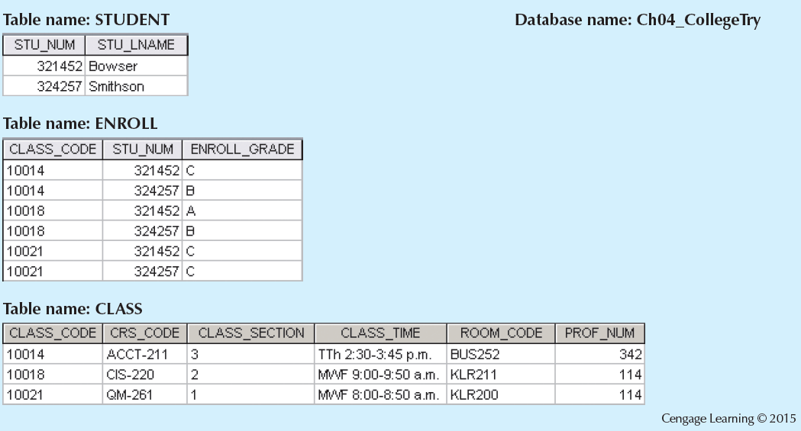
Figure 4.23 - Converting the M:N Relationship into Two 1:M Relationships

Slide 29
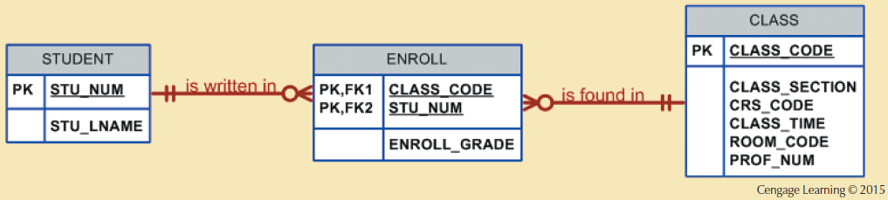
Figure 4.25 - A Composite Entity in an ERD

Slide 30
Developing an ER Diagram
Create a detailed narrative of the organization’s description of operations
Identify business rules based on the descriptions
Identify main entities and relationships from the business rules
Develop the initial ERD
Identify the attributes and primary keys that adequately describe entities
Revise and review ERD

Slide 31
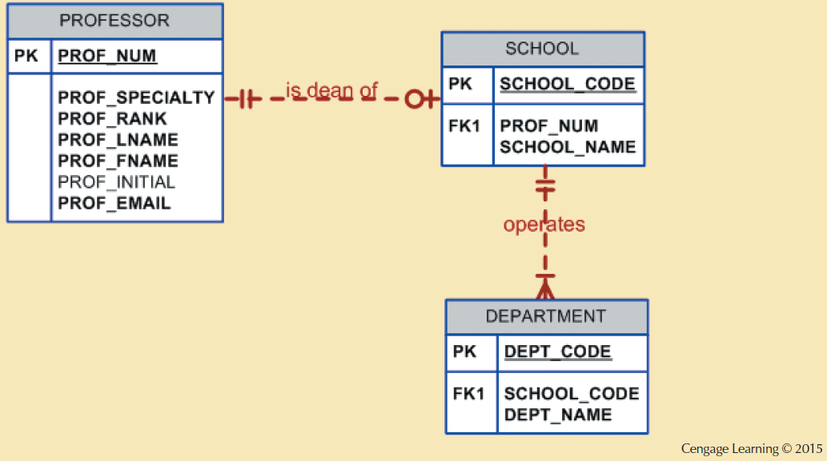
Figure 4.26 - The First Tiny College ERD Segment

Slide 32
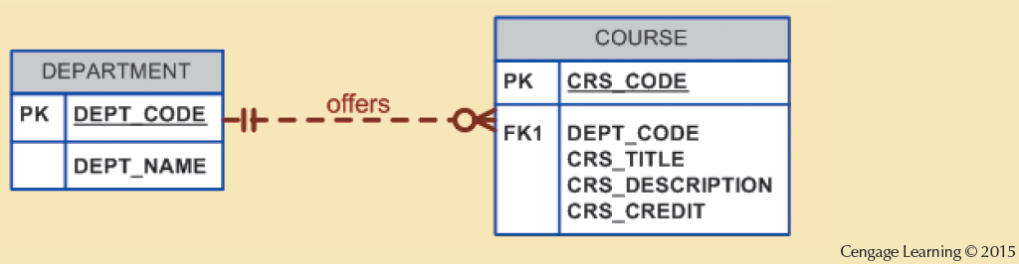
Figure 4.27 - The Second Tiny College ERD Segment

Slide 33
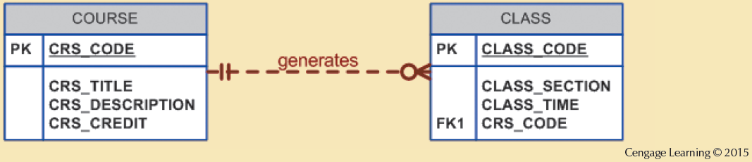
Figure 4.28 - The Third Tiny College ERD Segment

Slide 34
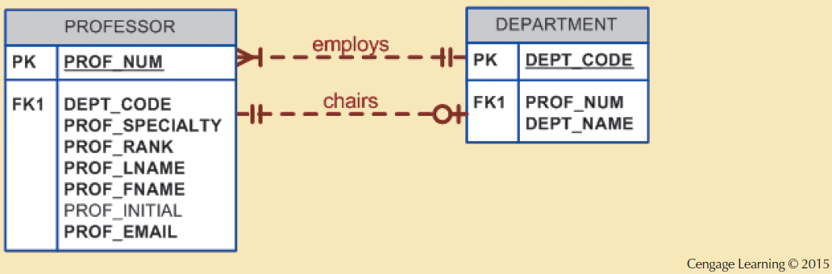
Figure 4.29 - The Fourth Tiny College ERD Segment

Slide 35
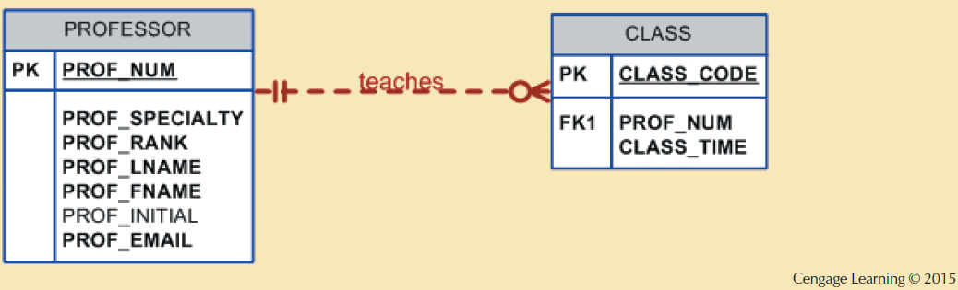
Figure 4.30 - The Fifth Tiny College ERD Segment

Slide 36
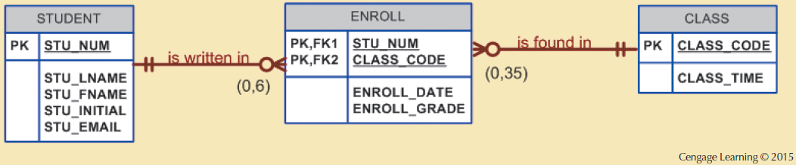
Figure 4.31 - The Sixth Tiny College ERD Segment

Slide 37
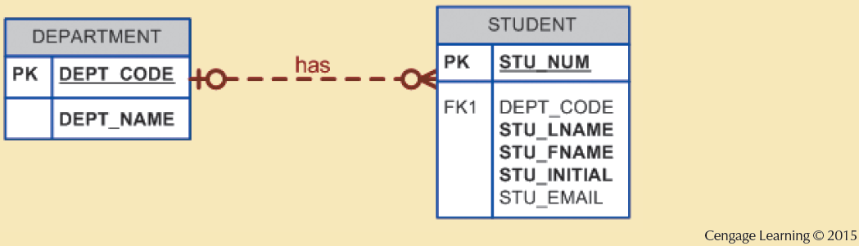
Figure 4.32 - The Seventh Tiny College ERD Segment

Slide 38
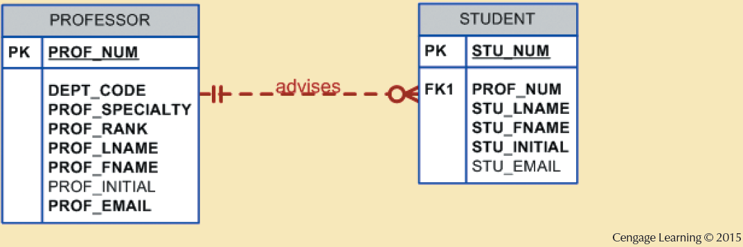
Figure 4.33 - The Eighth Tiny College ERD Segment

Slide 39
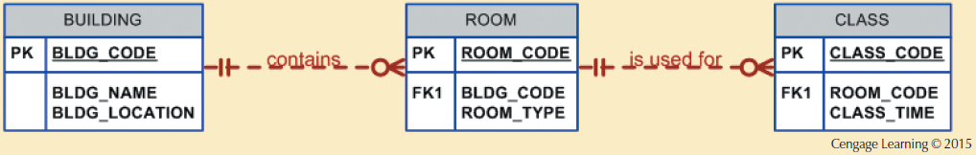
Figure 4.34 - The Ninth Tiny College ERD Segment

Slide 40
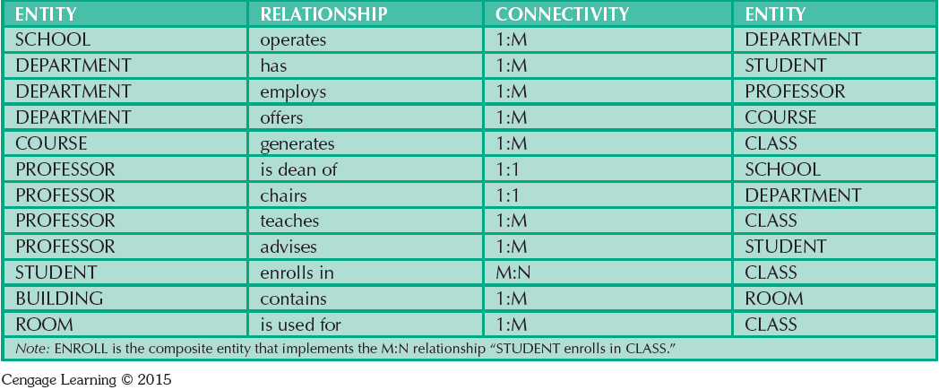
Table 4.4 - Components of the ERM

Slide 41
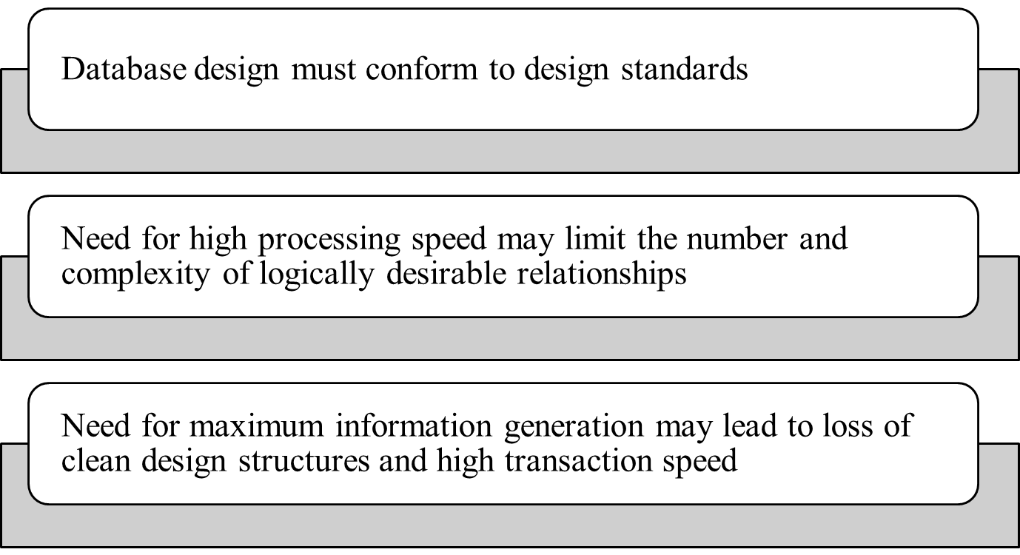
Database Design Challenges:
Conflicting Goals

Slide 42
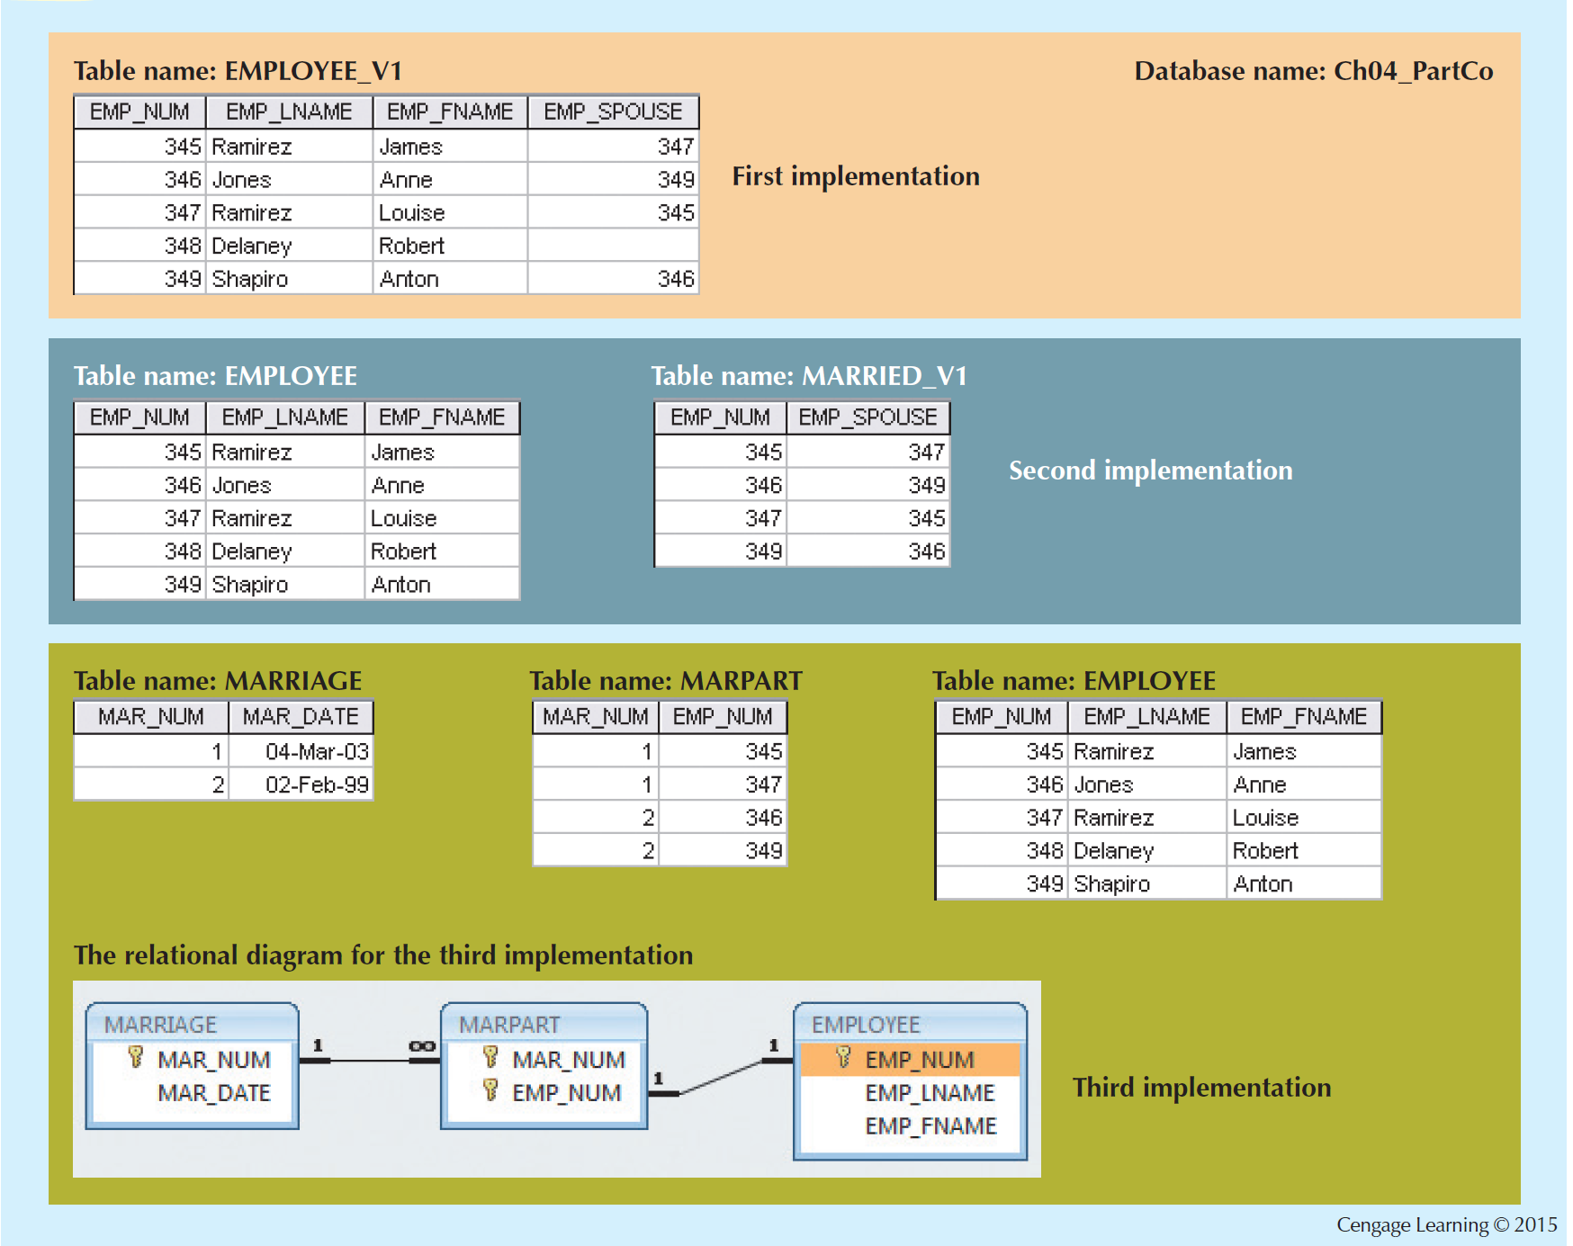
Figure 4.38 - Various Implementations of the 1:1 Recursive Relationship

